Slide 1
Database application development
INF08104: Database Systems
Brian Davison, 2013/14

Slide 2
Agenda
Objects and relations
Basic operations
Embedded SQL
Interoperability

Slide 3
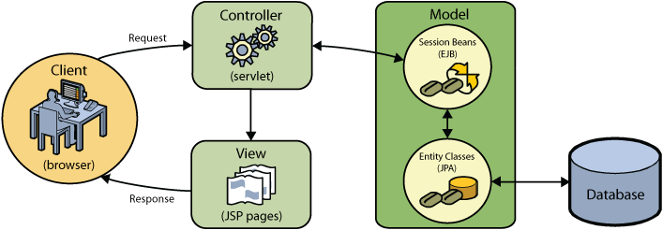
The role of databases
A specialist component in a larger system
Support for multiple concurrent users
Fine-grained access rights model
Secure and reliable backup facilities
Portability across multiple platforms (DBMS and operating systems)
http://netbeans.org

Slide 4
Objects and relations
Objects | Relations
Objects comprise data and procedures | Relations define data and relationships
Object model elaborated using generalisation, inheritance etc. | ER model elaborated using normalisation
Application is made up of objects | Database is separate from the application
Objects “die” when application terminates | Relations comprise persistent storage of data
Attributes can be complex types or other classes | Attributes comprise elementary data types

Slide 5
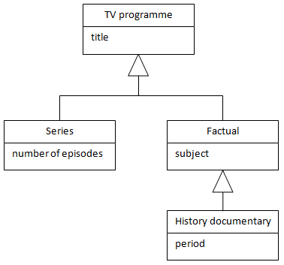
UML class diagrams

Slide 6
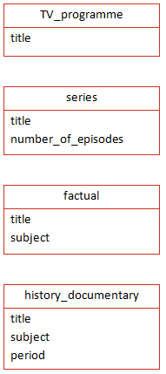
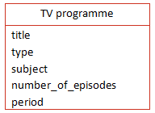
Mapping options
Single table
Multiple tables ➔
Issues
Many null values
Loss of generality

Slide 7
Restoring generality using views
CREATE VIEW all_programmes AS SELECT title, null, null, null FROM TV_programme UNION SELECT title, number_of_episodes, null, null FROM series UNION SELECT title, null, subject, null FROM factual UNION SELECT title, null, subject, period FROM history_documentary

Slide 8
Basic operations
Operation | SQL | HTTP
Create | INSERT | POST
Read | SELECT | GET
Update | UPDATE | PUT
Delete | DELETE | DELETE

Slide 9
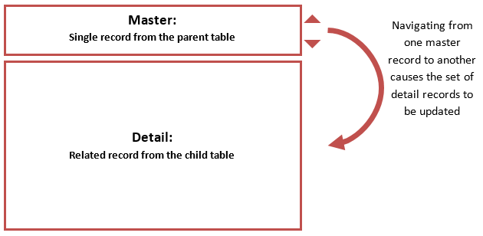
Interface design

Slide 10
Embedded SQL
Typical process
Connect
Prepare statement
Execute statement
Iterate over results held in a cursor

Slide 11
Different languages…
Java
Python
C#
import java.sql.Connection;
import java.sql.Statement;
import java.sql.DriverManager;
import java.sql.ResultSet;
public class Demo{
public static void main(String[] args) {
Connection myCon;
Statement myStmt;
try{
Class.forName("com.mysql.jdbc.Driver").newInstance();
myCon = DriverManager.getConnection(
"jdbc:mysql://127.0.0.1/gisq",
"scott","tiger");
myStmt = myCon.createStatement();
String sql =
"SELECT name, population FROM bbc "+
" WHERE population>200000000";
ResultSet cursor = myStmt.executeQuery(sql);
while (cursor.next()){
System.out.println(cursor.getString("name")+"\t"+
cursor.getLong("population"));
}
myCon.close();
}
catch (Exception sqlEx){
System.err.println(sqlEx);
}
}
}
import MySQLdb
dbh = MySQLdb.connect(host="127.0.0.1",\
user="scott",\
passwd="tiger", db="gisq")
sth = dbh.cursor()
sql = "SELECT name, population "+\
" FROM bbc "+\
" WHERE population>200000000"
sth.execute(sql)
for row in sth:
print row[0],row[1]
using System;
using System.Data.SqlClient;
class Demo {
public static void Main(string[] args) {
try {
SqlCommand comm = new SqlCommand();
comm.Connection = new SqlConnection( "Data Source=(local);"
+"Initial Catalog=gisq;“
+"user=scott;password=tiger;");
String sql = @"SELECT name, population FROM bbc WHERE population>200000000";
comm.CommandText = sql; comm.Connection.Open();
SqlDataReader cursor = comm.ExecuteReader();
while (cursor.Read())
Console.WriteLine(cursor["name"] + "\t"+ cursor["population"]);
comm.Connection.Close();
}
catch (Exception e){
Console.WriteLine(e.ToString());
}
}
}
PHP
<?
$dbh = mysql_connect('localhost','scott','tiger') or die(mysql_error());
mysql_select_db('gisq') or die(mysql_error());
$sql = "SELECT name, population FROM bbc “;
$sql += “WHERE population>1000000000";
$result = mysql_query($sql) or die(mysql_error());
while ($line = mysql_fetch_array($result)){
echo $line[0]."\t".$line[1]."\n";
}
mysql_close($dbh);
?>

Slide 12
Database connection
PHP
$db_host = "server_1"; $username = "hr"; $password = "hr";
mysql_connect($db_host, $username, $password);
C#
SqlConnection con =new SqlConnection(
"Data Source=(local);
Initial Catalog=gisq;user=scott;password=tiger;");
con.Open();

Slide 13
Constructing and sending a query
PHP
$query = " SELECT name FROM world "; $result = mysql_query($query);
C#
SqlCommand comm = new SqlCommand(
"SELECT name FROM world", con);
SqlDataReader cursor = comm.ExecuteReader();

Slide 14
Processing query results
PHP
echo "<table>"; while ($country = mysql_fetch_assoc($result)) { echo "<tr><td>" . $ country{name} . "</td></tr>"; } echo "</table>";
C#
while (cursor.Read()) {
Console.WriteLine(cursor["name"]);
}
cursor.Close();

Slide 15
Processing query results
PHP
echo "<table>"; while ($country = mysql_fetch_assoc($result)) { echo "<tr><td>" . $ country{name} . "</td></tr>"; } echo "</table>";
C#
while (cursor.Read()) {
Console.WriteLine(cursor["name"]);
}
cursor.Close();

Slide 16
DML
PHP
$query = “INSERT INTO world (name,population,gdp) “;
$query += “VALUES (‘Scotland’, 5300000, 146000000000) ";
$result = mysql_query($query);
C#
String sql = @"INSERT INTO world (name,population,gdp)
VALUES (‘Scotland', 5300000, 146000000000) ";
SqlCommand comm = new SqlCommand(sql,con);
comm.ExecuteNonQuery();

Slide 17
Issues
Resolving special characters
eg. single/double quotes, semicolon, ampersand
Datatype conversion
casting
Null values
eg. a database NULL is different to a C# null
Error handling
Use try { } catch { }
Provide feedback on number of rows processed

Slide 18
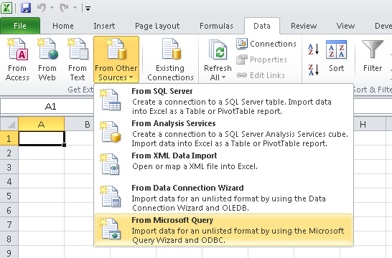
Interoperability
JDBC
Database connection from Java
Oracle tutorial
ODBC
Connectivity for desktop tools
Microsoft reference
Structured text
Data exchange
XML
JSON

